Slide 1
JAVA PROGRAMMING
Chap 5 : String Handling

Slide 2

A string is a sequence of characters surrounded by double quotations.
In a java programming language, a string is the object of a built-in class String.
In the background, the string values are organized as an array of a character data type.
The string created using a character array can not be extended.
It does not allow to append more characters after its definition, but it can be modified.
The Java String is immutable by default which means it cannot be changed.
Whenever we change any string, a new instance is created.
For mutable strings, you can use StringBuffer and StringBuilder classes.
Syntax :
char[] name = {'J', 'a', 'v', 'a', ' ', 'T', 'u', 't', 'o', 'r', 'i', 'a', 'l', 's'};
// name[14] = '@‘; //ArrayIndexOutOfBoundsException when trying to add more characters to the string
System.out.println(name);
name[4] = '-'; // modifying the string
System.out.println(name);

Slide 3

The String class defined in the package java.lang package.
The String class implements Serializable, Comparable, and CharSequence interfaces.
Java String class provides a lot of methods to perform operations on strings such as compare(), concat(), equals(), split(), length(), replace(), compareTo(), intern(), substring() etc.
The string created using the String class can be extended.
It allows us to add more characters after its definition, and also it can be modified.
Syntax :
String name = "Java Tutorials";
System.out.println(name);
name = "Java Programming";
System.out.println(name);

Slide 4

Creating String object in Java
In java, we can use the following two ways to create a string object.
Using string literal
Using String constructor
Syntax :
String title = "Java Tutorials"; // Using literals
String name = new String("Java Programming"); // Using constructor
System.out.println(title);
System.out.println(name);
char ch[]={'S','t','r','i','n','g','s'};
String s=new String(ch); //converting char array to string using constructor
System.out.println(s);

Slide 5

Why are String objects immutable?
A String is an unavoidable type of variable while writing any application program.
String references are used to store various attributes like username, password, etc.
In Java, String objects are immutable. Immutable simply means unmodifiable or unchangeable.
Once String object is created its data or state can't be changed but a new String object is created.
Let's try to understand the concept of immutability by the example given below:
String s="Java";
s.concat(" Programming"); //concat() method appends the string at the end
System.out.println(s); //will print Java because strings are immutable objects
Now it can be understood that Java is not changed but a new object is created with Java Programming and s reference variable still refers to “Java" and not to “Java Programming". That is why String is known as immutable.
But if we explicitly assign it to the reference variable, it will refer to “Java Programming" object. Please notice that still “Java” object is not modified, only that the reference variable refers to the new object.
String s="Java";
s=s.concat(" Programming");
System.out.println(s);

Slide 6
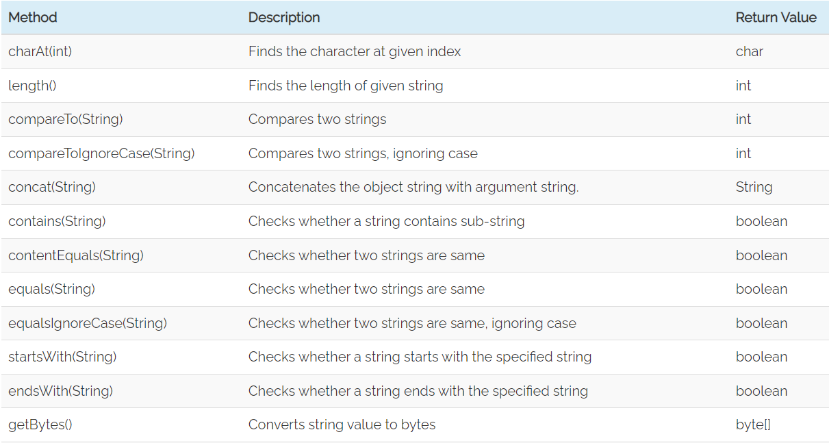
String Handling Methods

Slide 7
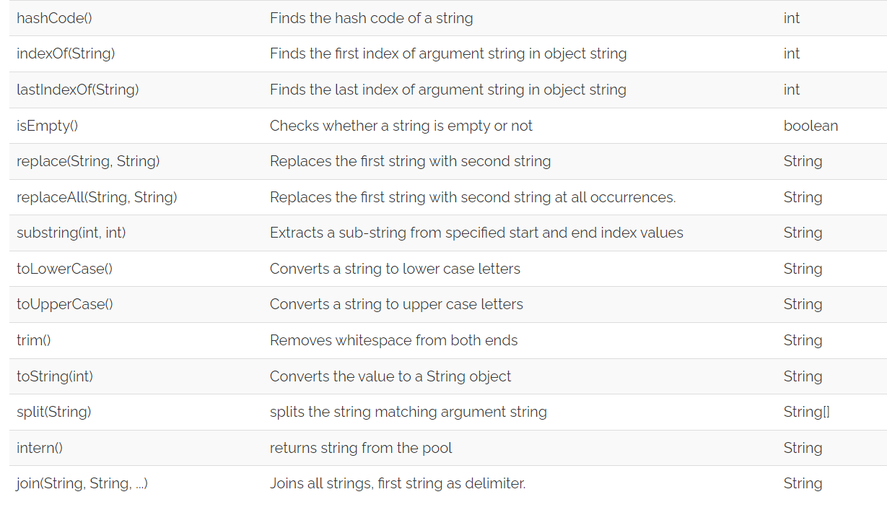
String Handling Methods

Slide 8
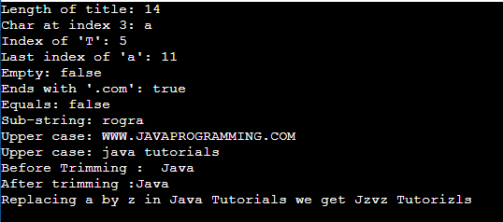
String Handling Methods
public class Main {
public static void main(String[] args) {
String title = "Java Tutorials";
String Name = "www.javaprogramming.com";
System.out.println("Length of title: " + title.length());
System.out.println("Char at index 3: " + title.charAt(3));
System.out.println("Index of 'T': " + title.indexOf('T'));
System.out.println("Last index of 'a': " + title.lastIndexOf('a'));
System.out.println("Empty: " + title.isEmpty());
System.out.println("Ends with '.com': " + Name.endsWith(".com"));
System.out.println("Equals: " + Name.equals(title));
System.out.println("Sub-string: " + Name.substring(9, 14));
System.out.println("Upper case: " + Name.toUpperCase());
System.out.println("Upper case: " + title.toLowerCase());
String s=" Java ";
System.out.println("Before Trimming :"+s);
System.out.println("After trimming :"+s.trim());
System.out.println("Replacing a by z in " + title + " we get " + title.replace("a","z"));
}
}

Slide 9
String Compare
We can compare String in Java on the basis of content and reference.
It is used in authentication (by equals() method), sorting (by compareTo() method), reference matching (by == operator) etc.
There are three ways to compare String in Java:
By Using equals() Method
By Using == Operator
By compareTo() Method
The String class equals() method compares the original content of the string. It compares values of string for equality. String class provides the following two methods:
public boolean equals(Object another) compares this string to the specified object.
public boolean equalsIgnoreCase(String another) compares this string to another string, ignoring case.
Eg 1: String s1=“Java”;
String s2=“Java”;
String s3=new String(“Java”);
String s4=“Python”;
System.out.println(s1.equals(s2)); // o/p will be true
System.out.println(s1.equals(s3)); // o/p will be true
System.out.println(s1.equals(s4)); // o/p will be false
Eg 2: String s1=“Java”;
String s2=“JAVA”;
System.out.println(s1.equals(s2)); //false System.out.println(s1.equalsIgnoreCase(s2)); //true

Slide 10
String Compare
The == operator compares references not values.
Eg 1: String s1=“Java”;
String s2=“Java”;
String s3=new String(“Java”);
System.out.println(s1==s2); // o/p will be true (because both refer to same instance)
System.out.println(s1==s3); // o/p will be false(because s3 refers to another instance created)
The String class compareTo() method compares values lexicographically and returns an integer value that describes if first string is less than, equal to or greater than second string.
Suppose s1 and s2 are two String objects. If:
s1 == s2 : The method returns 0.
s1 > s2 : The method returns a positive value.
s1 < s2 : The method returns a negative value.
Eg : String s1=“Java”;
String s2=“Java”;
String s3=“Jp”;
System.out.println(s1.compareTo(s2)); //0
System.out.println(s1.compareTo(s3)); //-15 (because s1<s3 and “a” is 15 times lower than “p”)
System.out.println(s3.compareTo(s1)); //15 (because s3 > s1 and “p” is 15 times greater than “a” )

Slide 11
String Concatenation
In Java, String concatenation forms a new String that is the combination of multiple strings. There are two ways to concatenate strings in Java:
By + (String concatenation) operator
By concat() method
Eg 1:
String s="Java"+" Programming";
String s1=50+30+" JP "+40+40;
System.out.println(s); // Java Programming
System.out.println(s1); //80 JP 4040 Note: After a string literal, all the + will be treated as string concatenation operator.
String s2=" by Oracle";
String s3=s.concat(s2);
System.out.println(s3); // Java Programming by Oracle

Slide 12
StringBuffer Class
Java StringBuffer class is used to create mutable (modifiable) String objects.
A String that can be modified or changed is known as mutable String. StringBuffer and StringBuilder classes are used for creating mutable strings.
The StringBuffer class in Java is the same as String class except it is mutable i.e. it can be changed.
Important Constructors of StringBuffer Class
StringBuffer() : It creates an empty String buffer with the initial capacity of 16. If the number of the character increases from its current capacity, it increases the capacity by (oldcapacity*2)+2.
StringBuffer(String str) : It creates a String buffer with the specified string.
StringBuffer(int capacity) : It creates an empty String buffer with the specified capacity as length.

Slide 13
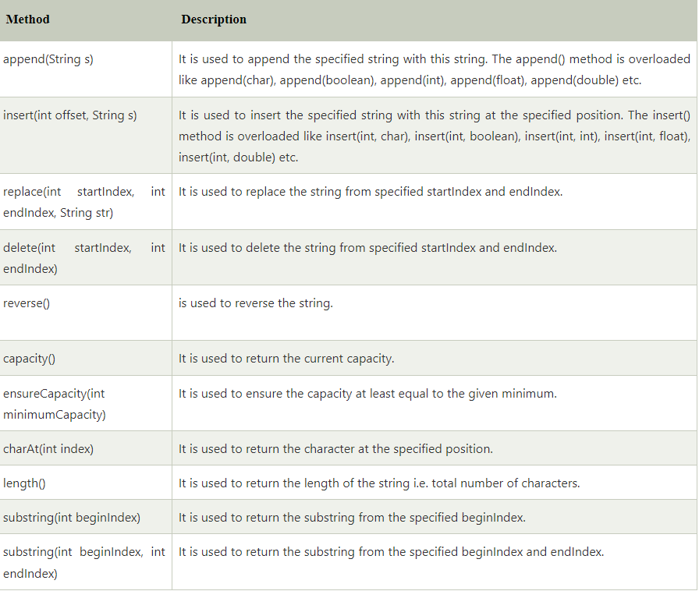
Important methods of StringBuffer class

Slide 14
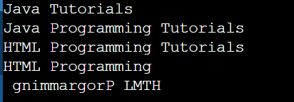
StringBuffer Class Example
public class Main {
public static void main(String[] args) {
StringBuffer sb=new StringBuffer("Java");
System.out.println(sb.append(" Tutorials")); //original string Java is changed to Java Tutorials
System.out.println(sb.insert(5, "Programming ")); // inserts the given String in original string at the given position
System.out.println(sb.replace(0,4, "HTML")); // replaces the given String from the specified beginIndex and endIndex.
System.out.println(sb.delete(17,26)); //deletes the String from the specified beginIndex to endIndex.
System.out.println(sb.reverse()); // reverses the String
}
}

Slide 15
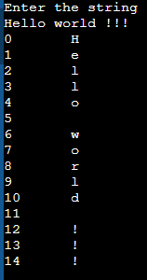
WAP to convert a string into an array of characters and display each character with its index
import java.util.*;
public class Main{
public static void main(String[] args) {
String str;
int i,n;
Scanner sc=new Scanner(System.in); System.out.println("Enter the string"); str=sc.nextLine();
n=str.length();
char c[]=new char[n];
c=str.toCharArray();
for(i=0;i<=n-1;i++)
{
System.out.println(i+"\t"+c[i]);
}
}
}

Slide 16
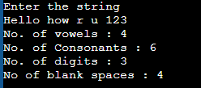
WAP to count number of vowels, consonants, digits and blank spaces in a string
import java.util.*;
public class Main{
public static void main(String[] args) {
String str;
int i,n,v=0,co=0,d=0,bs=0;
Scanner sc=new Scanner(System.in);
System.out.println("Enter the string");
str=sc.nextLine();
n=str.length();
char c[]=new char[n];
c=str.toCharArray();
for(i=0;i<=n-1;i++)
{
if(c[i]=='a' || c[i]=='e' || c[i]=='i' || c[i]=='o' || c[i]=='u' || c[i]=='A' || c[i]=='E' || c[i]=='I' || c[i]=='O' || c[i]=='U')
v++;
else if(c[i]==' ' )
bs++;
else if(c[i]>='0' && c[i]<='9')
d++;
else if((c[i]>='a' && c[i]<='z') || (c[i]>='A' && c[i]<='Z')
co++;
}
System.out.println("No. of vowels : " + v + "\nNo. of Consonants : " + co + "\nNo. of digits : " + d + "\nNo of blank spaces : " + bs);
}}

Slide 17
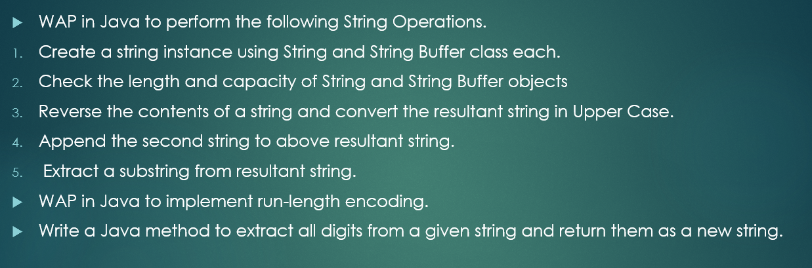
Programming Practice Questions

